Slide 1
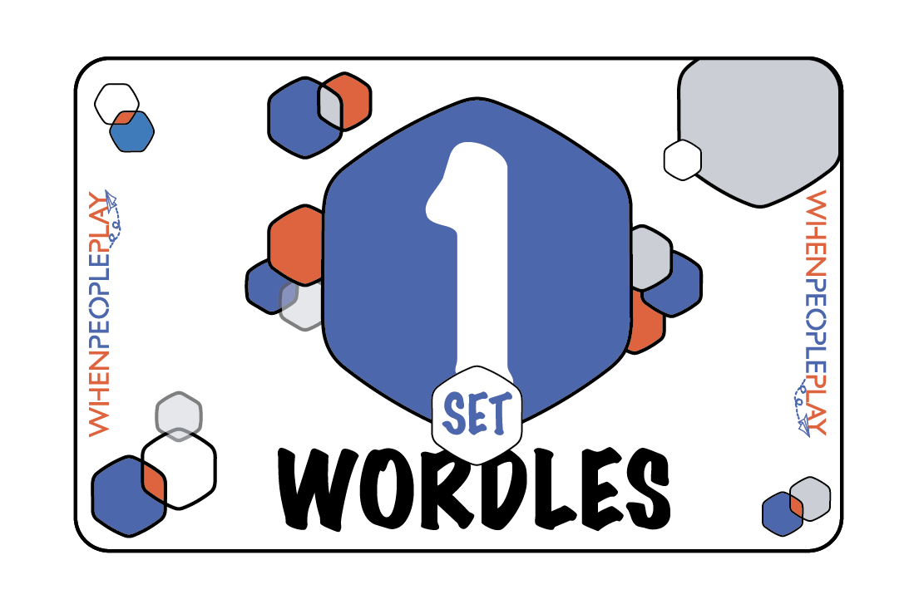
Welcome! Below is how to use this PowerPoint. Be creative. Use them to fit your needs.
Slides 2 - 9 can be used for Virtual Presentations. Mix and match as you wish.
Slides 10 - 17 are the answers for the cards for each card.
Slides 18 – 25 are for Wordle Speed Match.
Slide 26 are answer cards to be printed for the Racing Rebus activity.

Slide 2
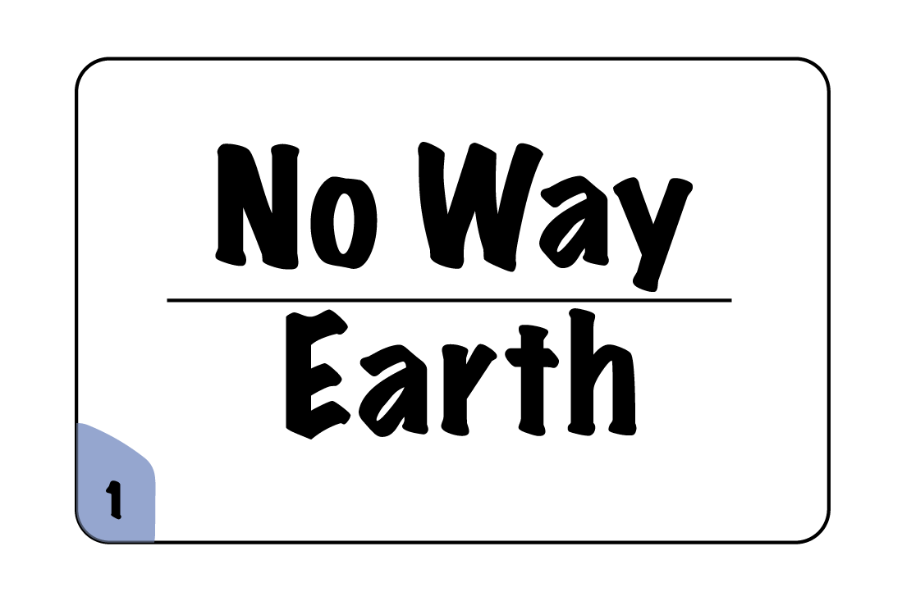
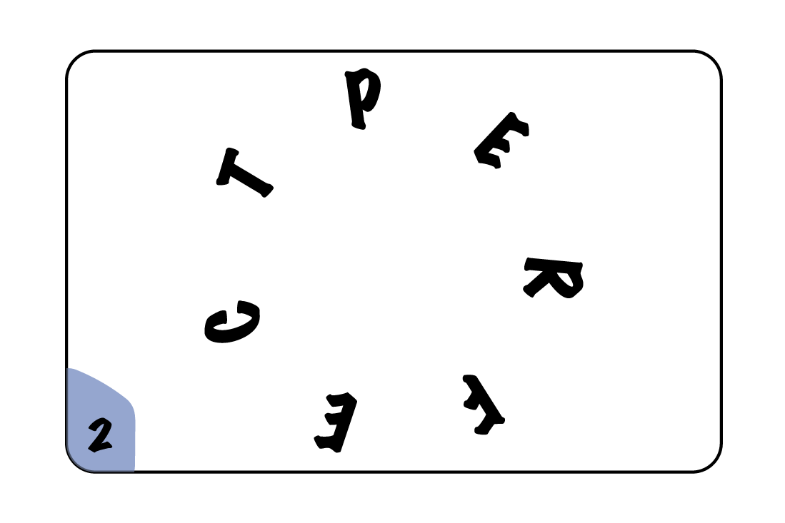
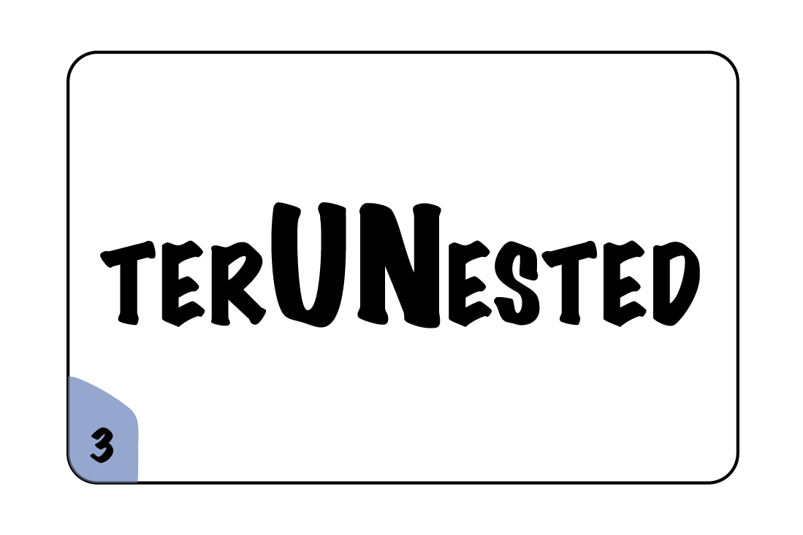
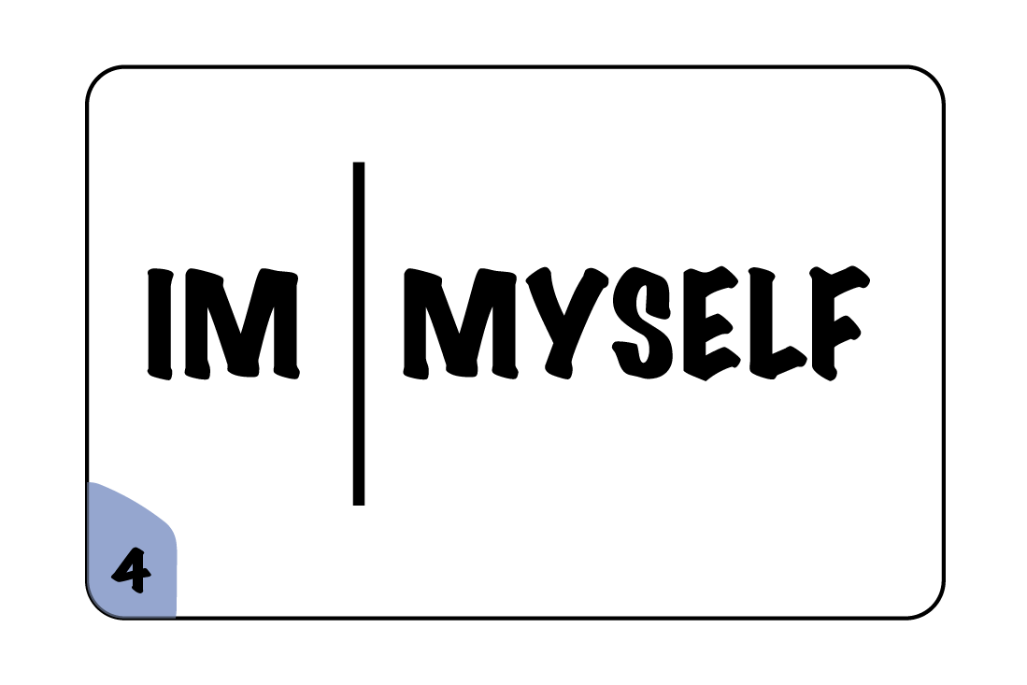
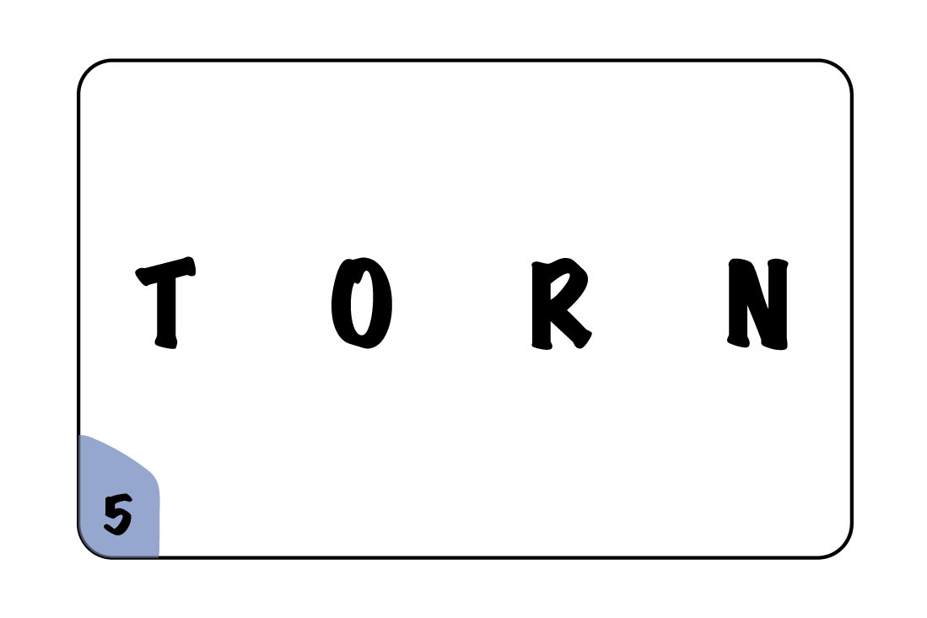
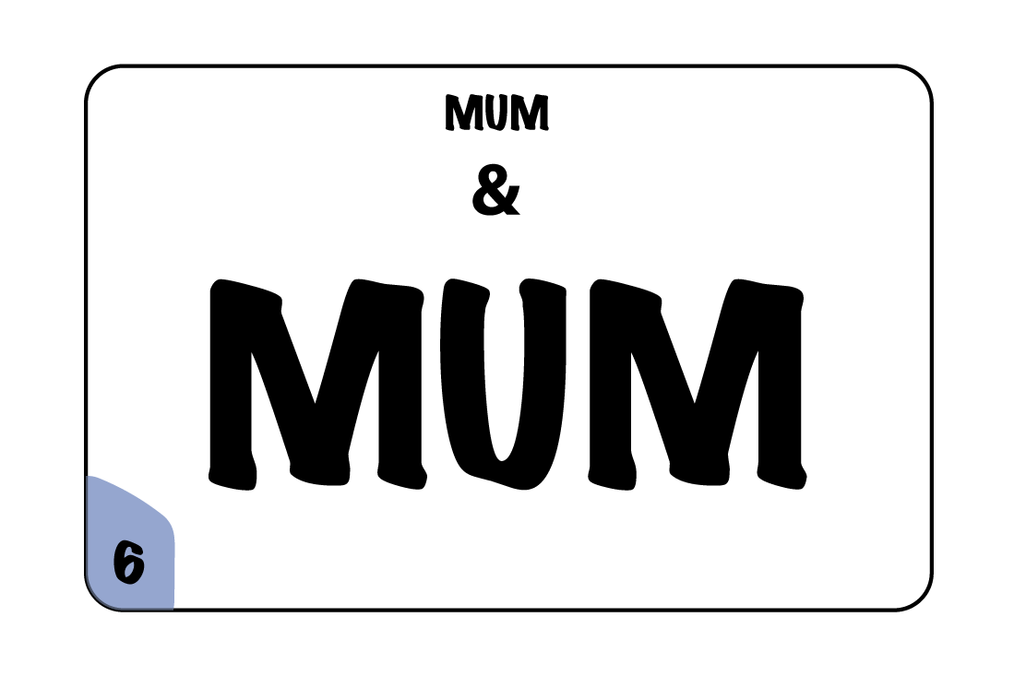

Slide 3
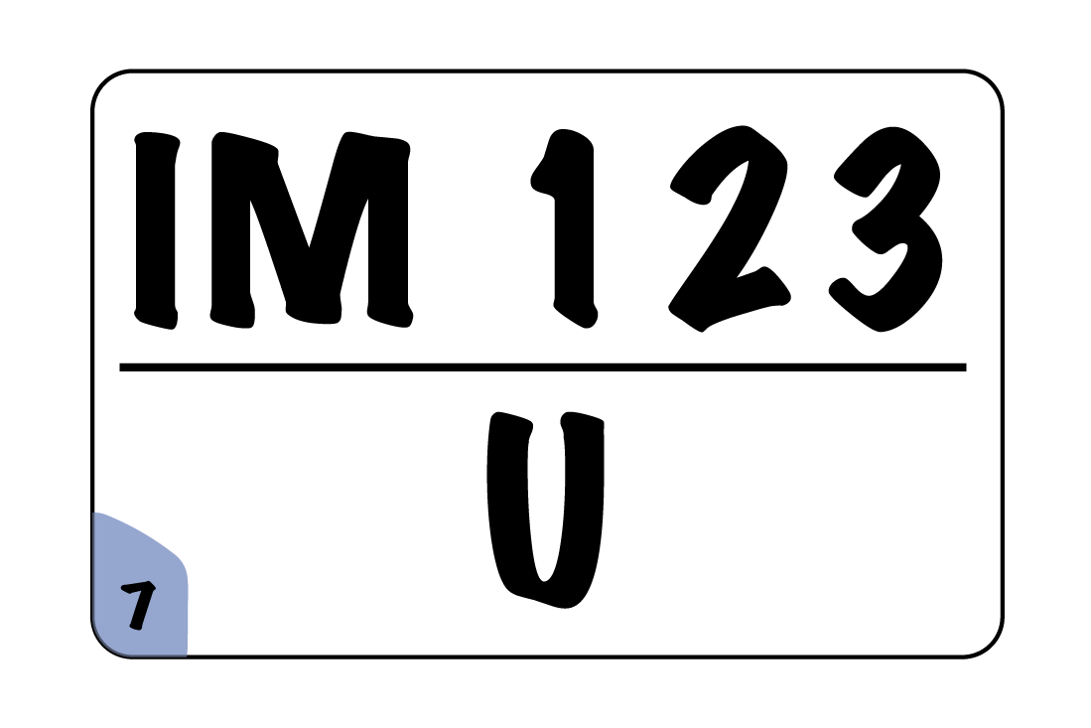
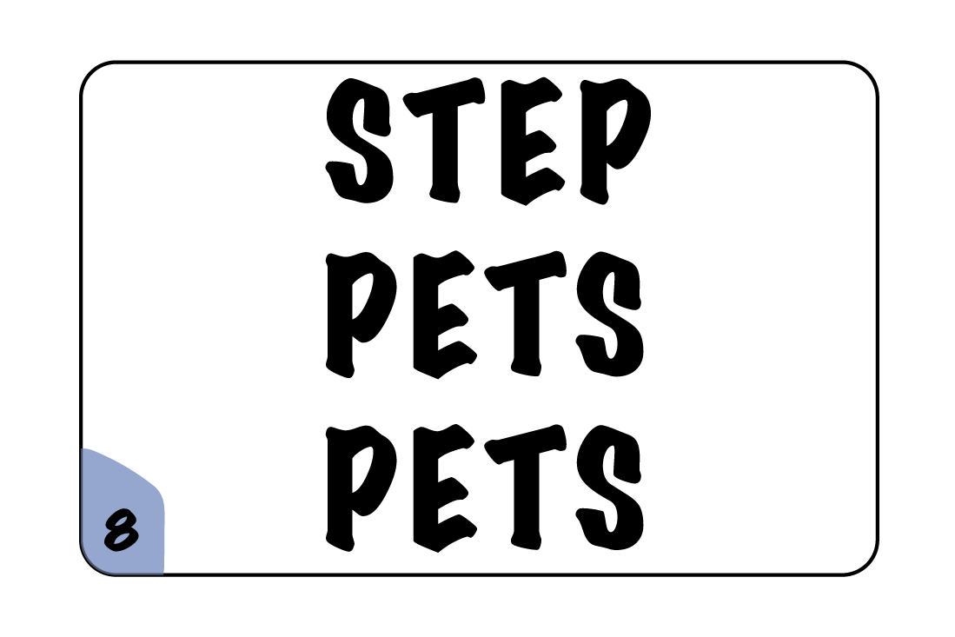
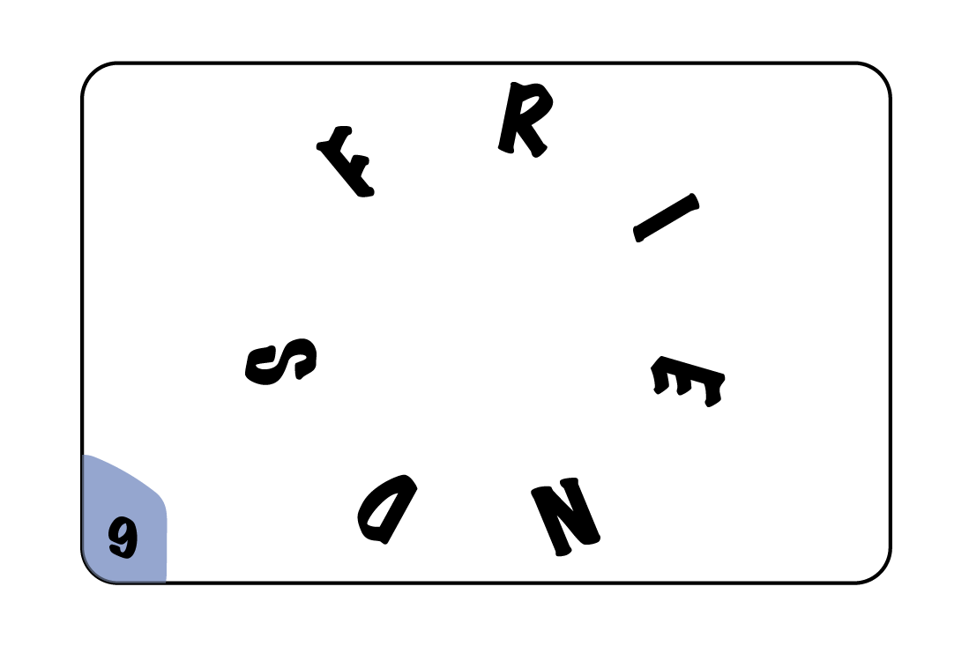
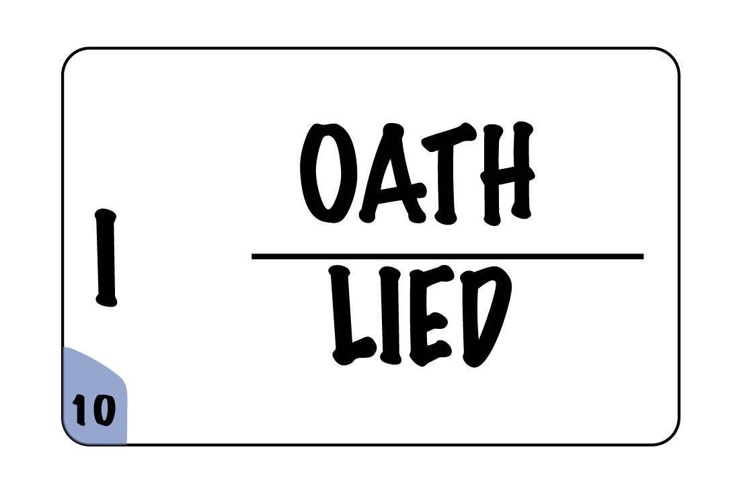
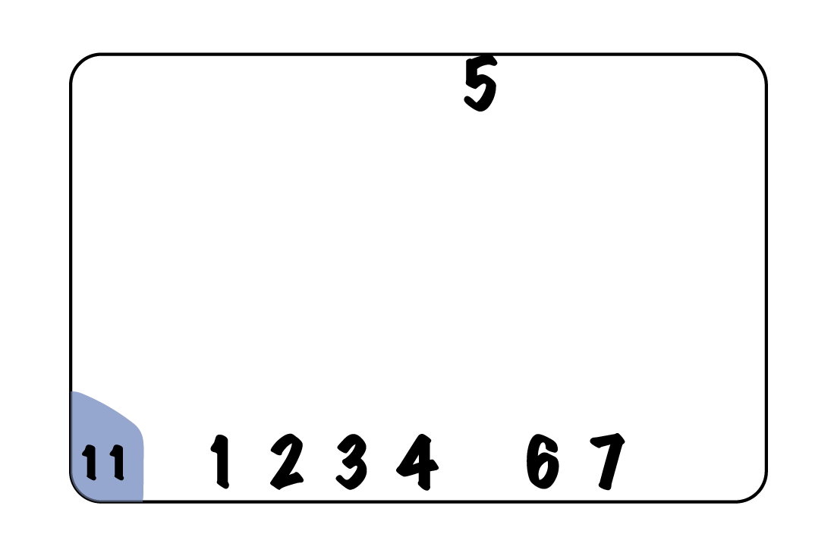


Slide 4
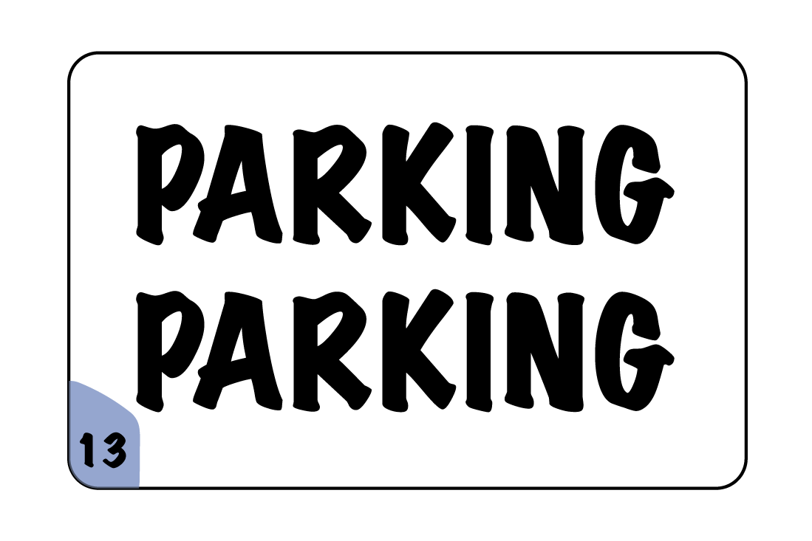
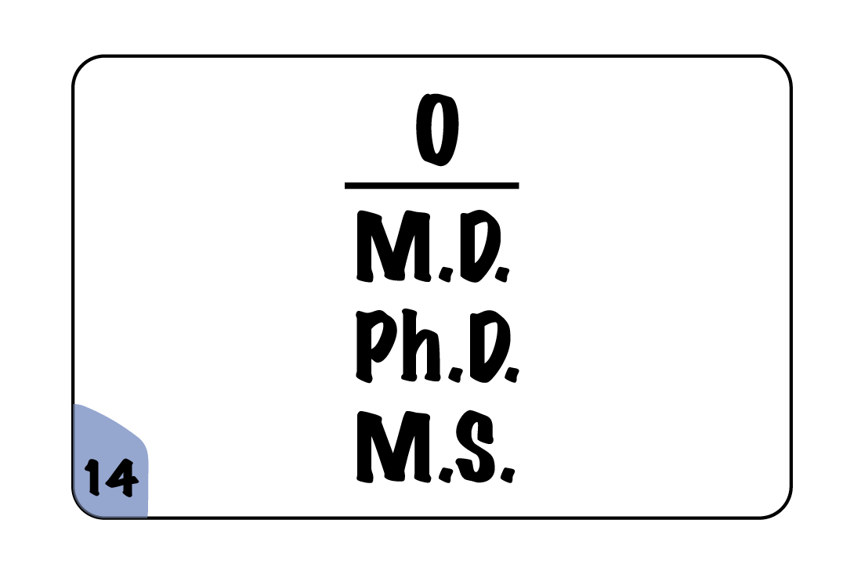
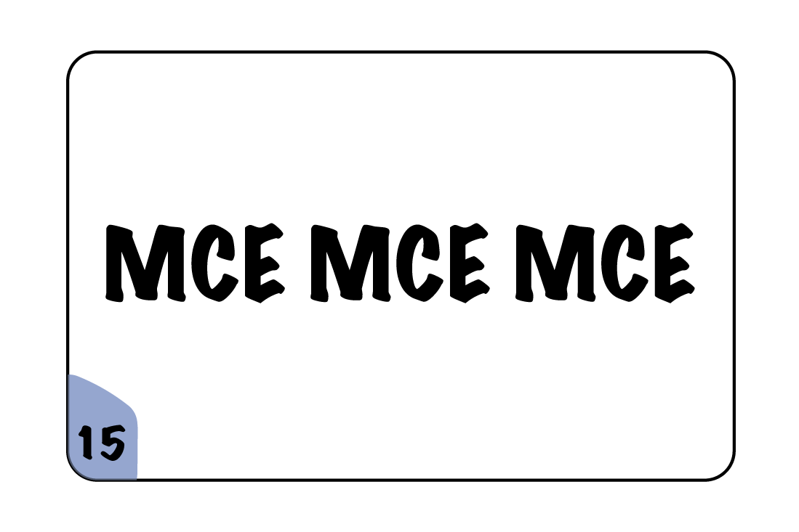
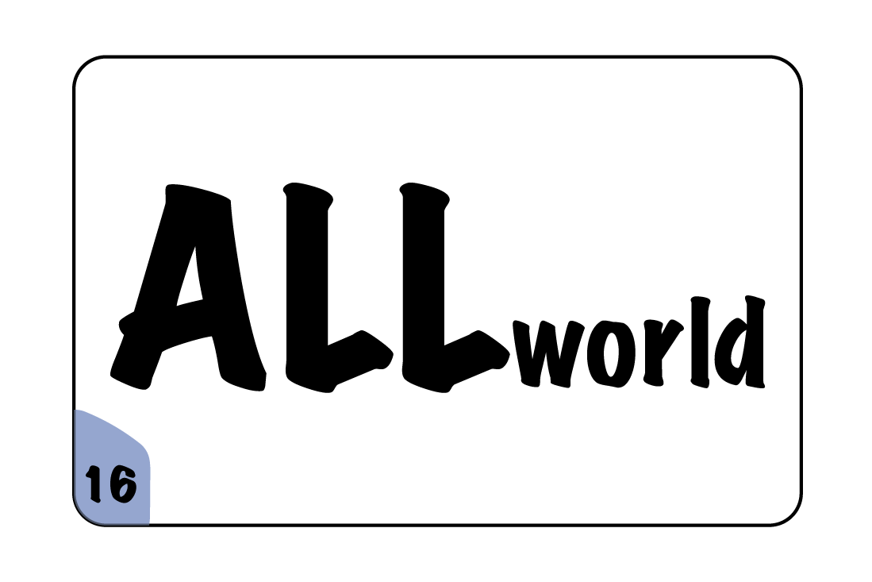
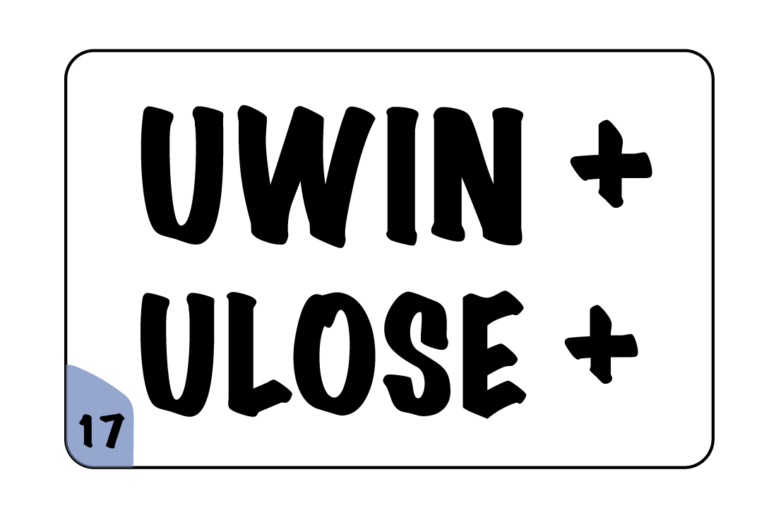
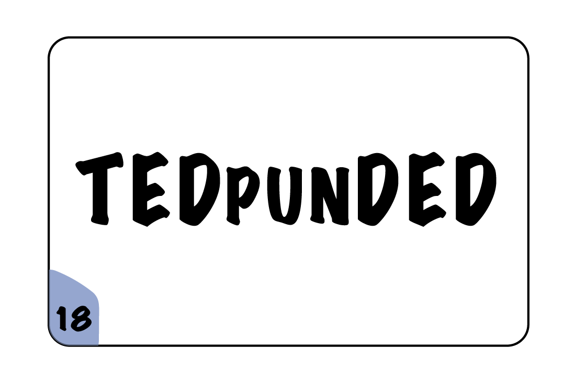

Slide 5
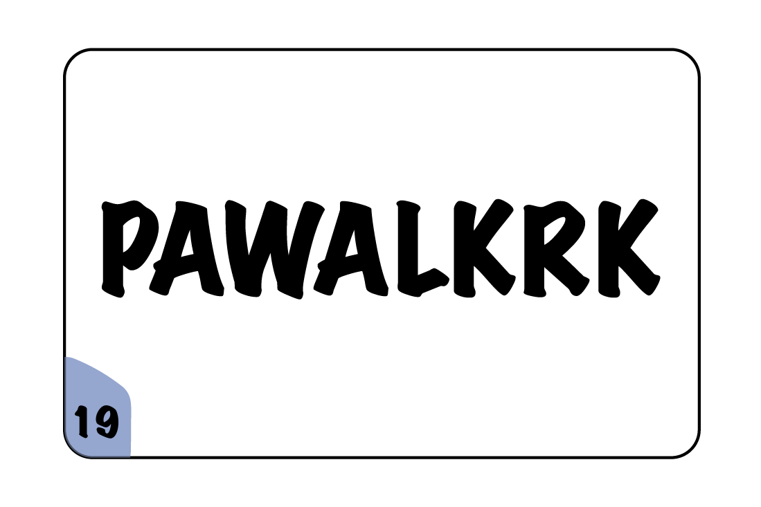
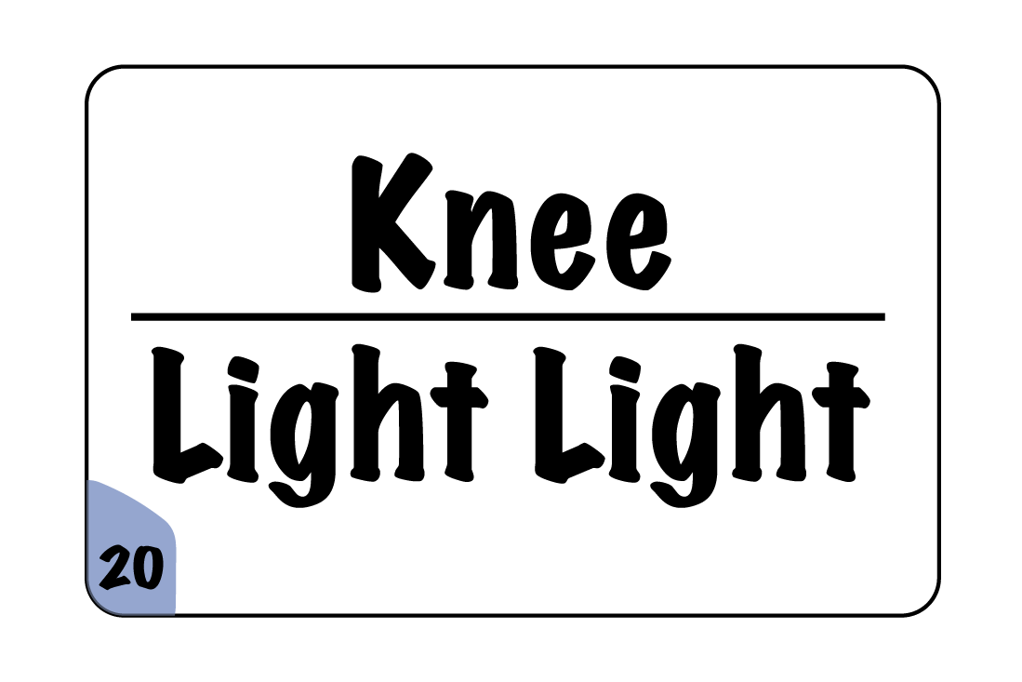
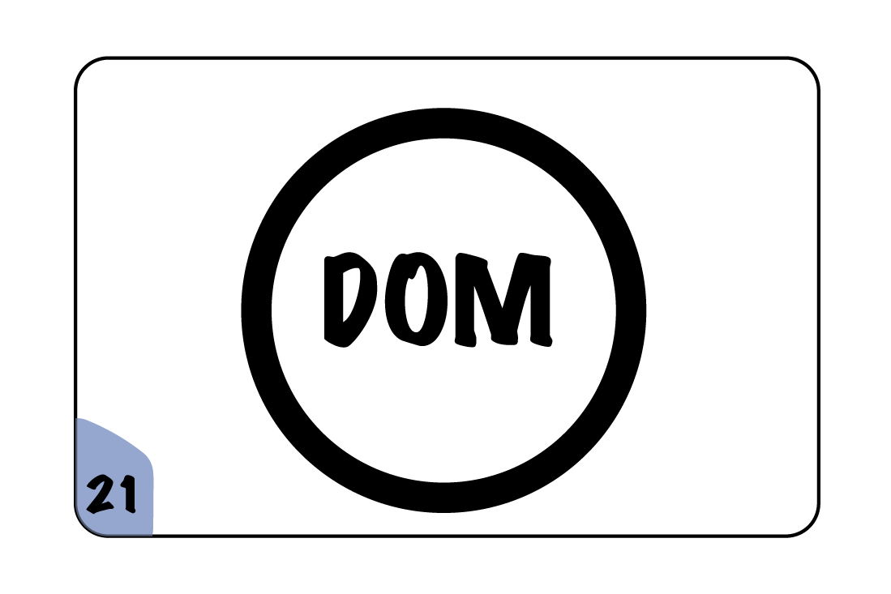
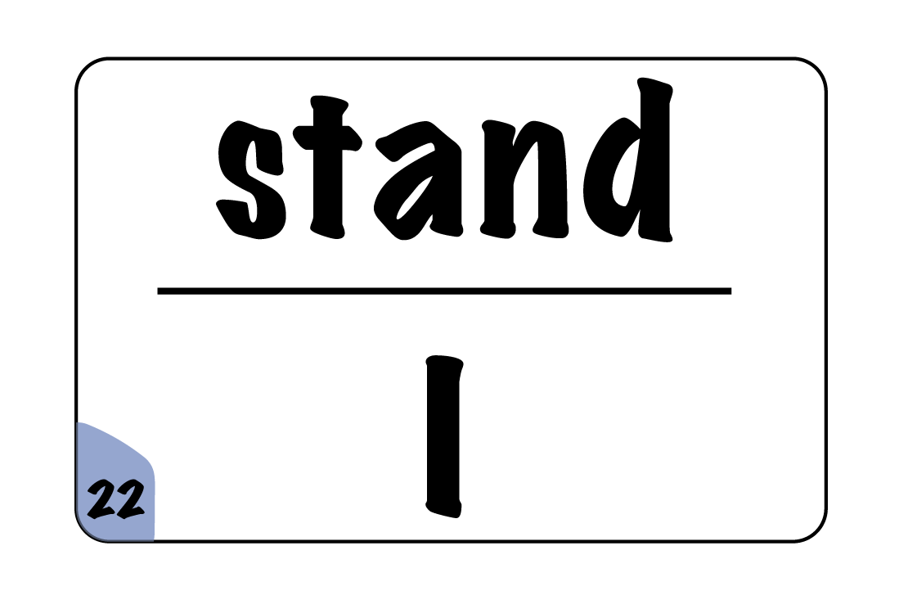
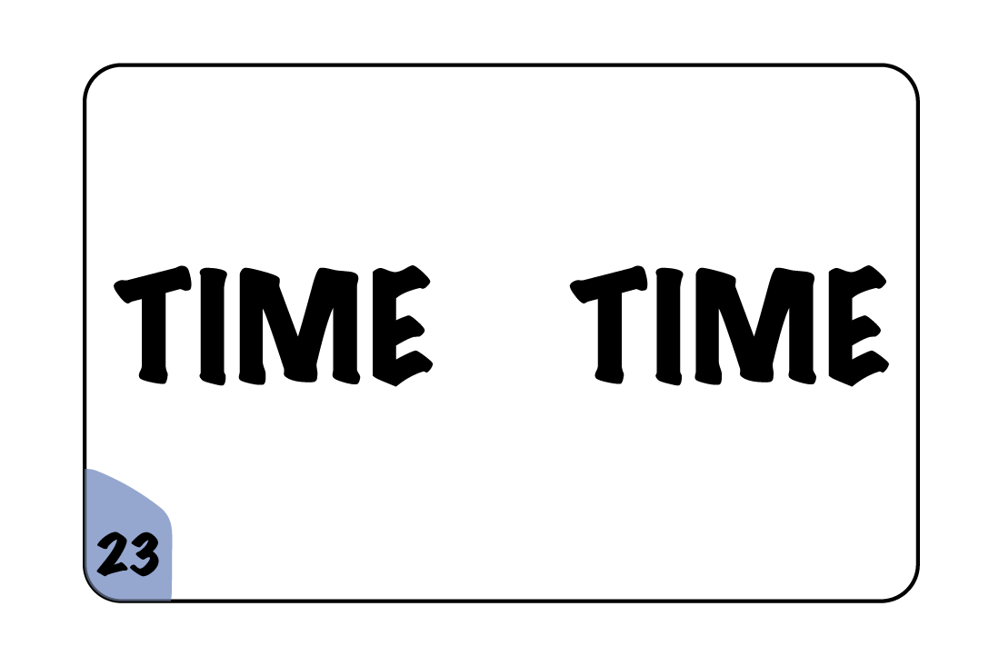


Slide 6
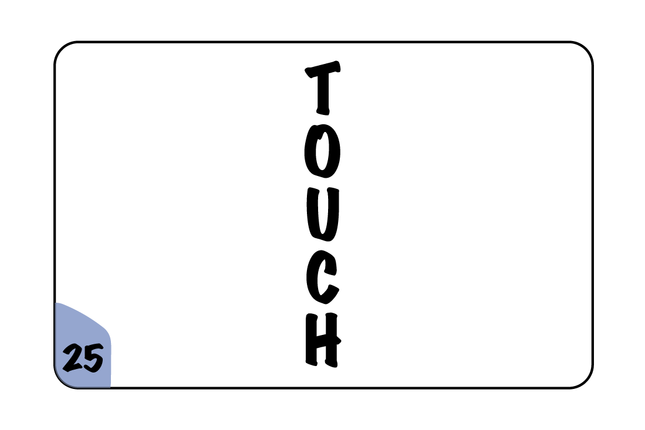
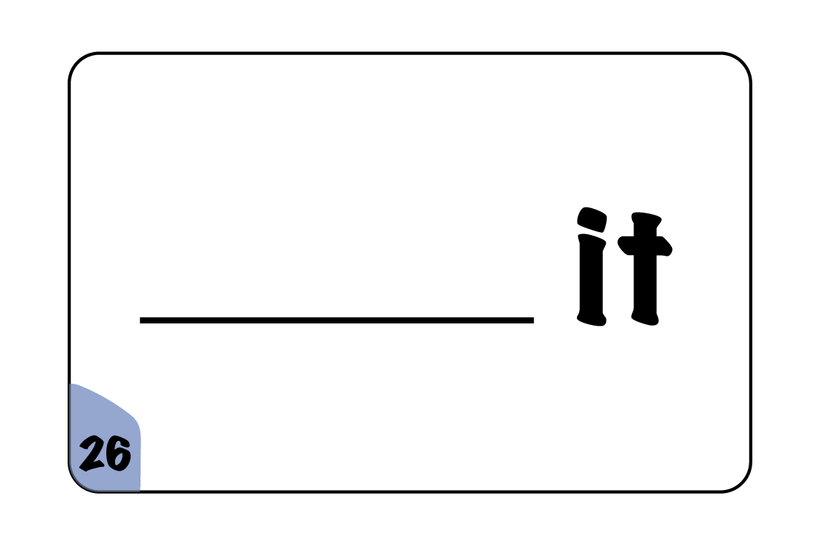
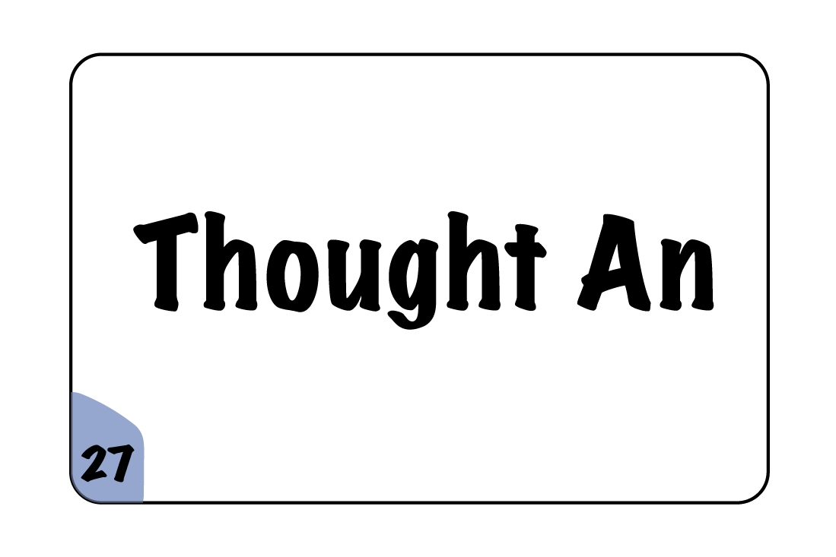

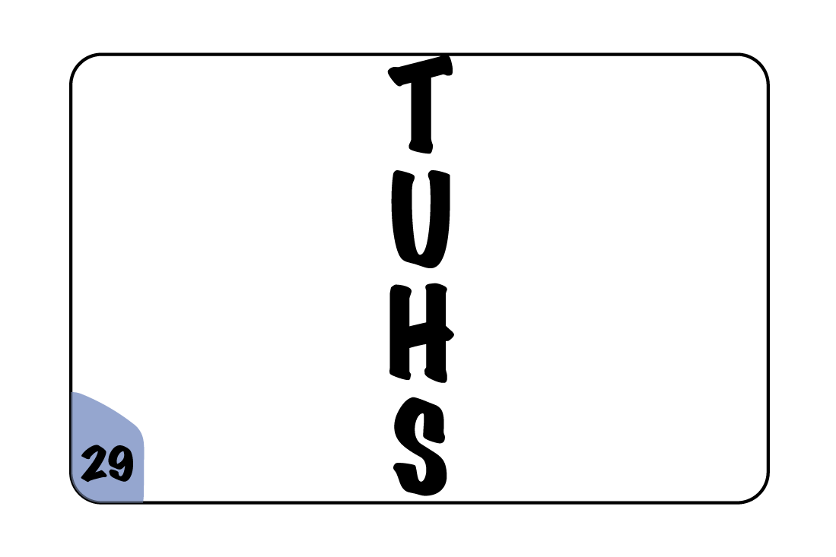
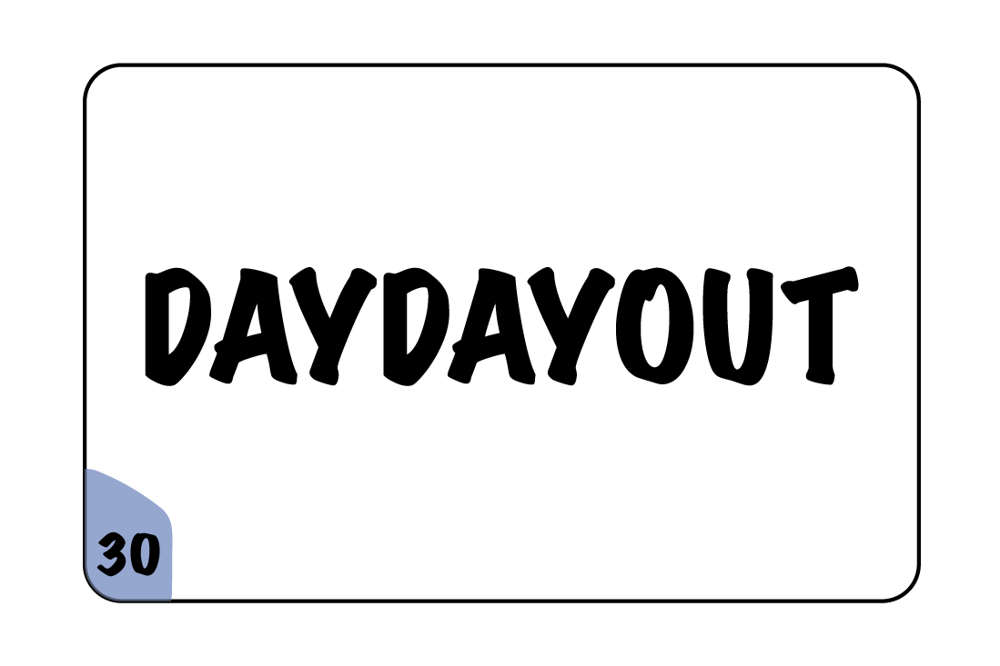

Slide 7

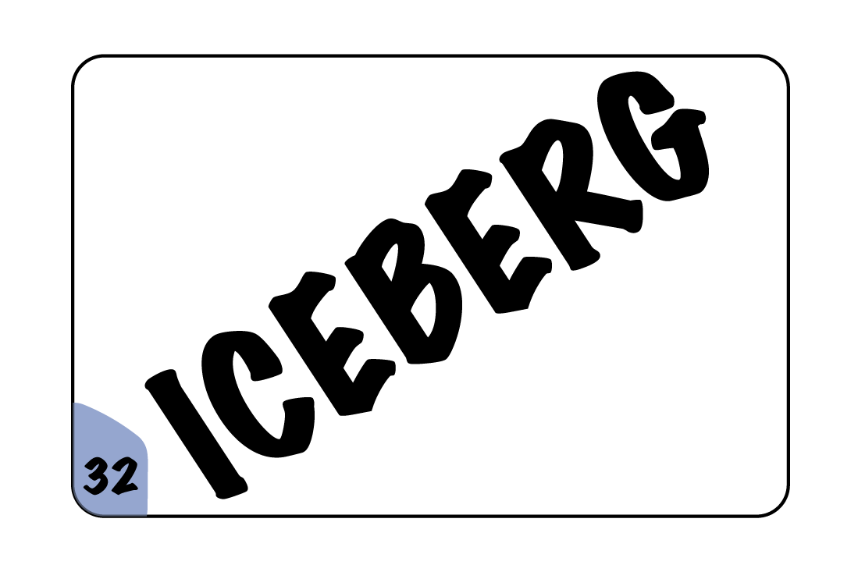


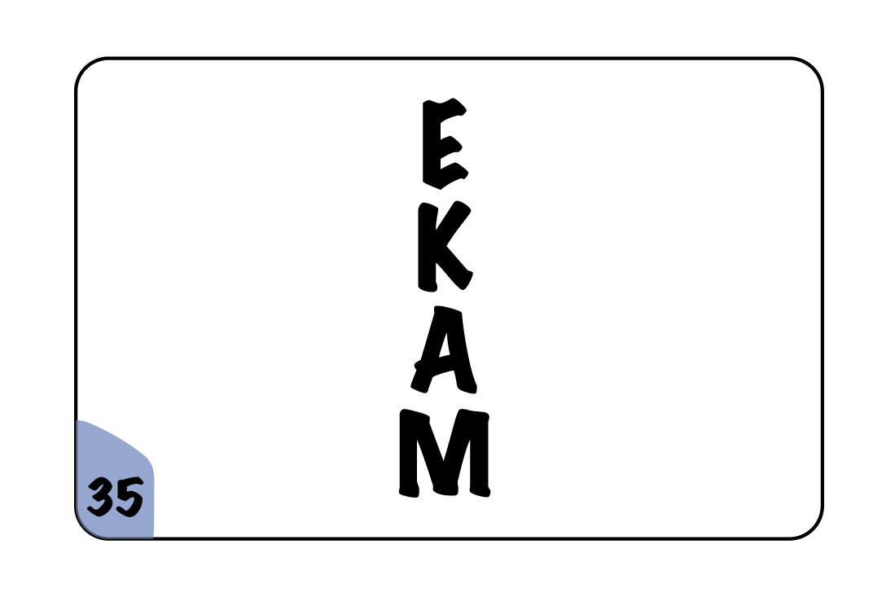
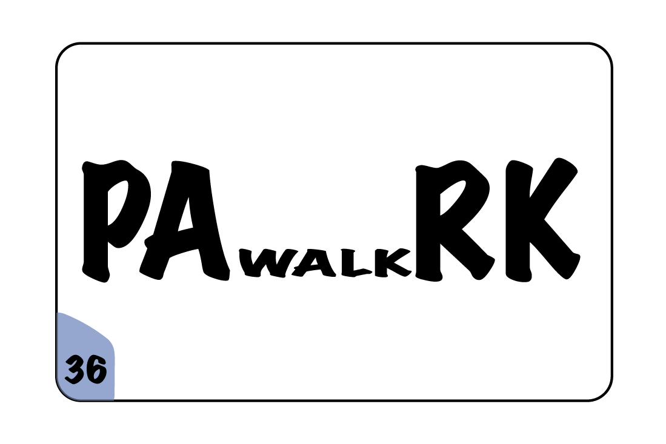

Slide 8
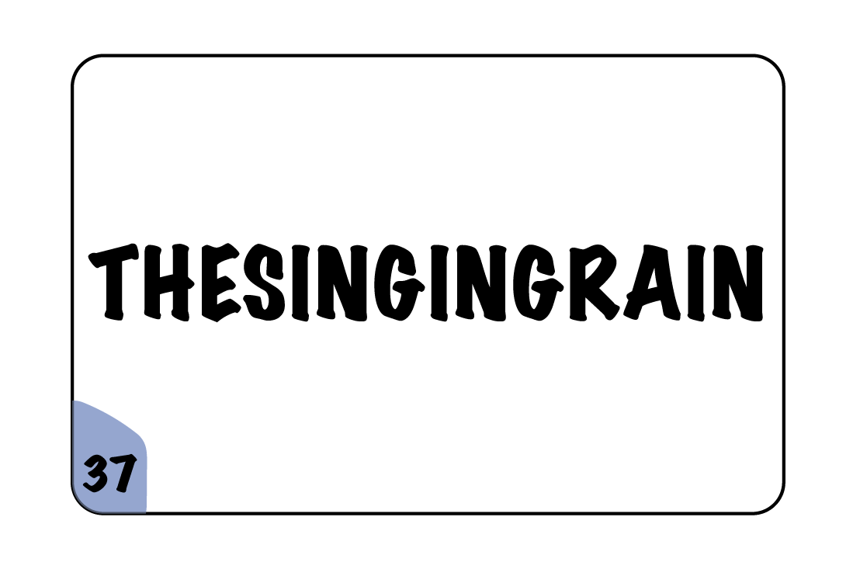
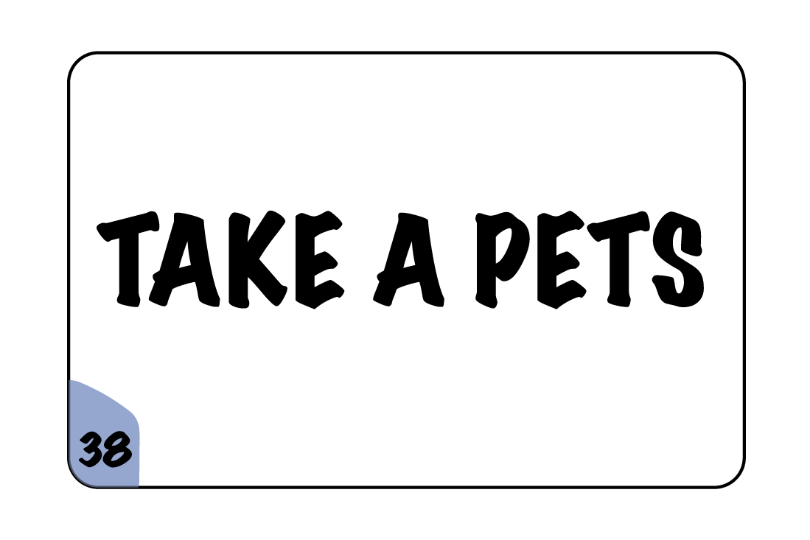
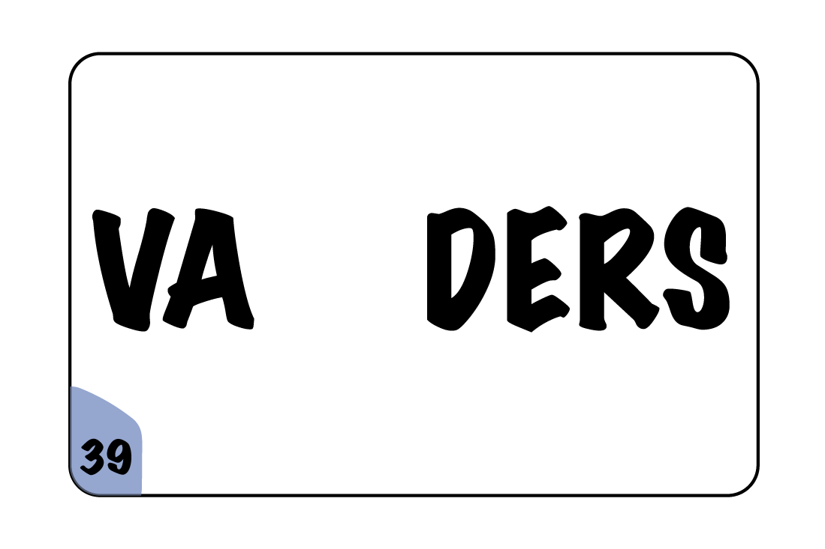

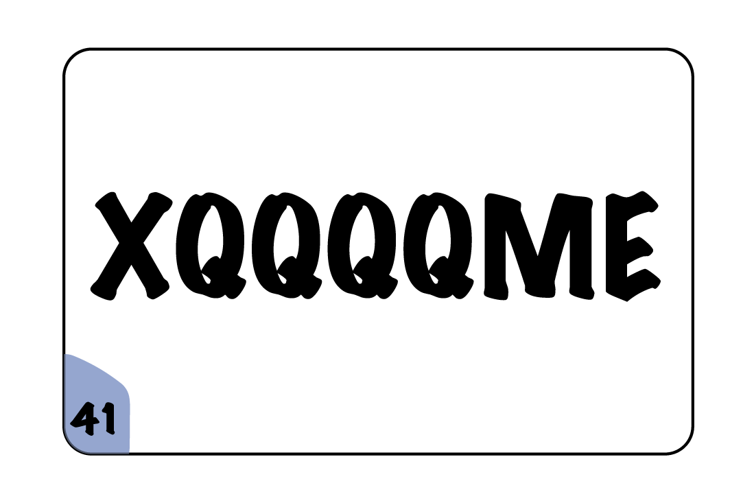


Slide 9
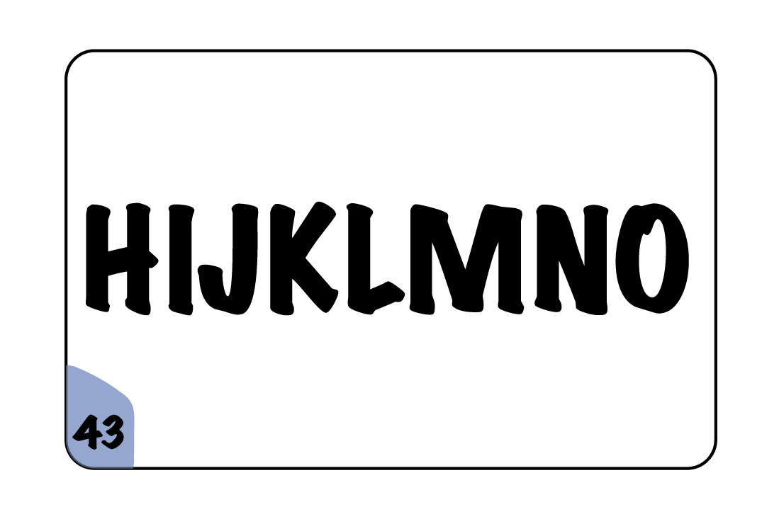

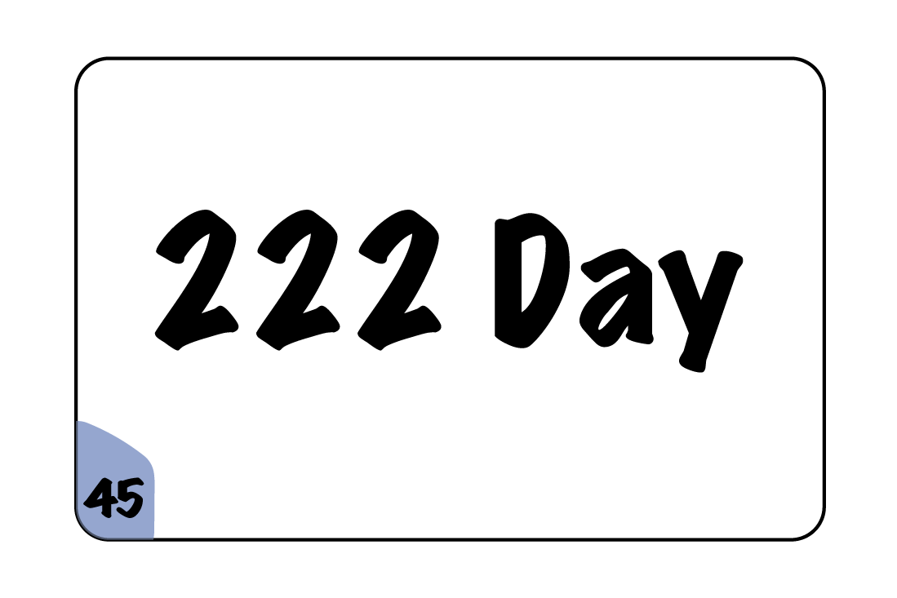
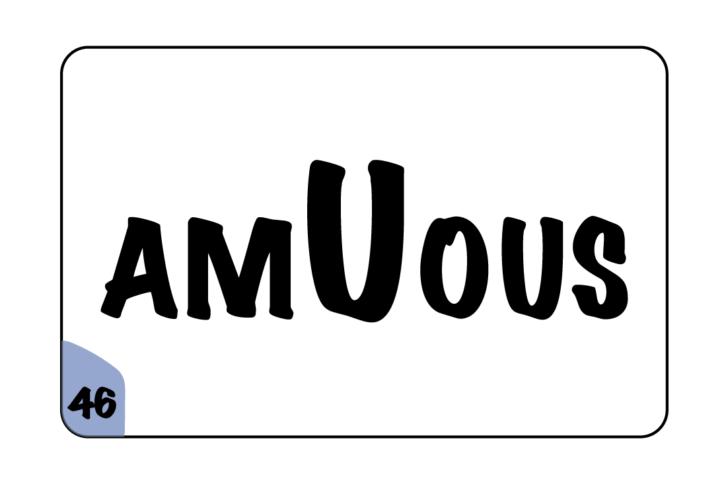
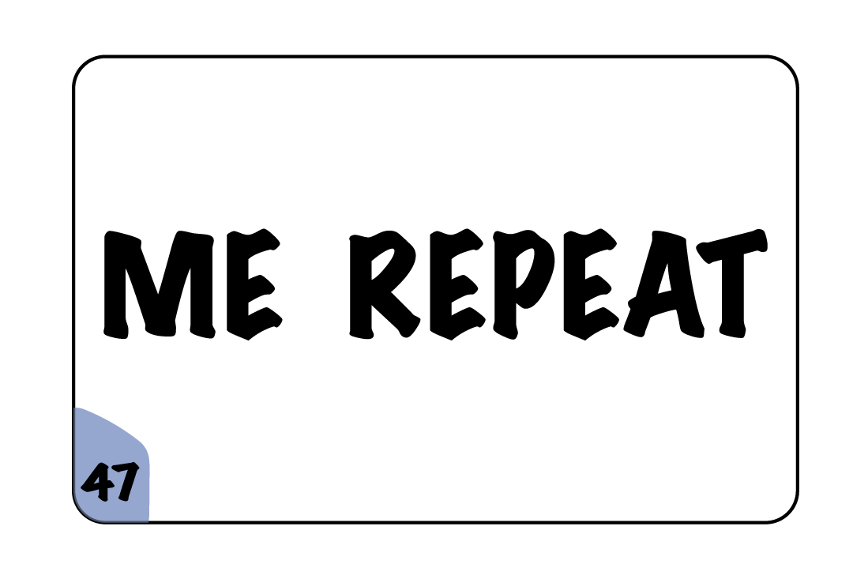
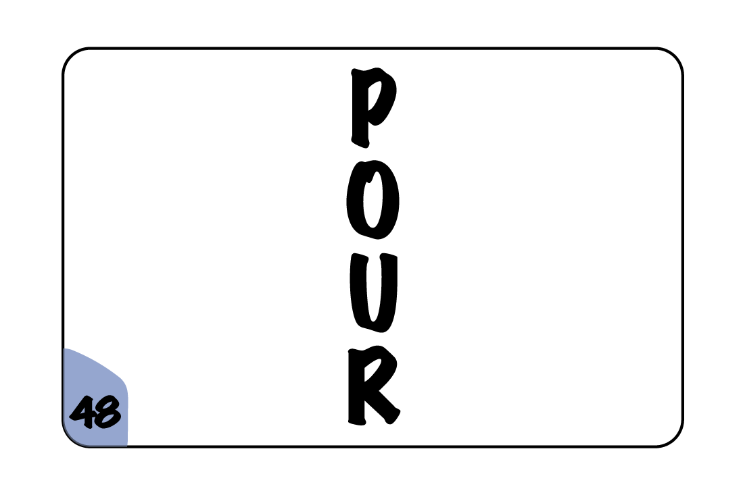

Slide 10
No Way On Earth
Perfect circle
Uninterested
I’m beside myself
Torn apart
Minimum and Maximum

Slide 11
I’m counting on you
One step forward two steps back
Circle of friends
I lied under oath
High five
Working under cover

Slide 12

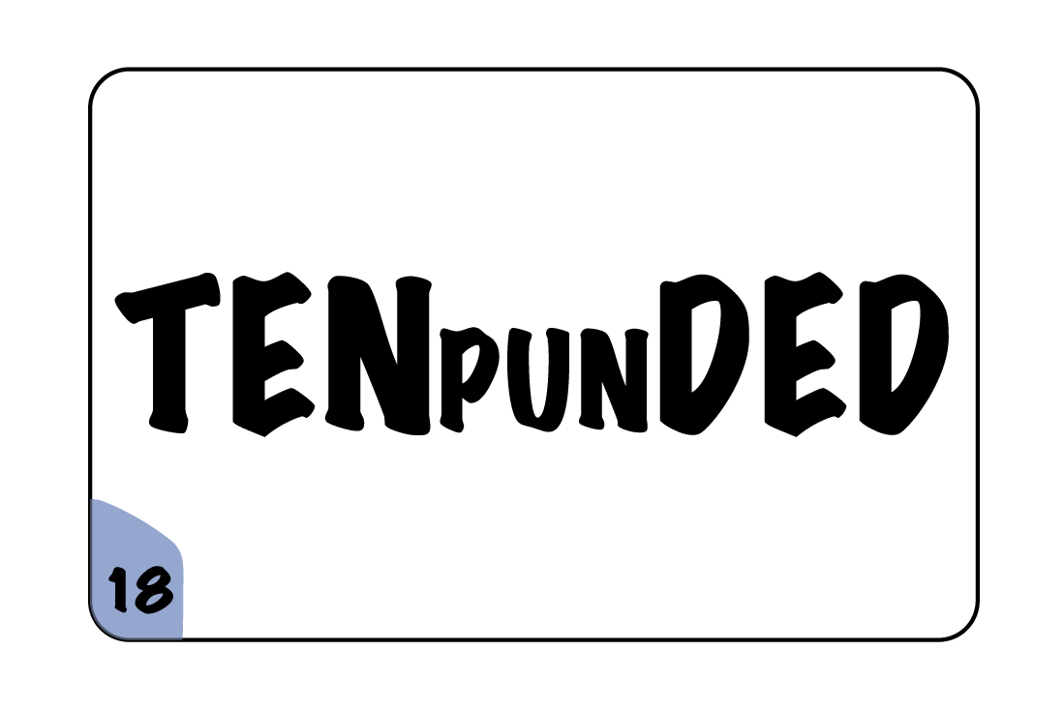
Double parking
Three degrees below zero
Third blind mice
Small world after all
I understand
Pun intended

Slide 13
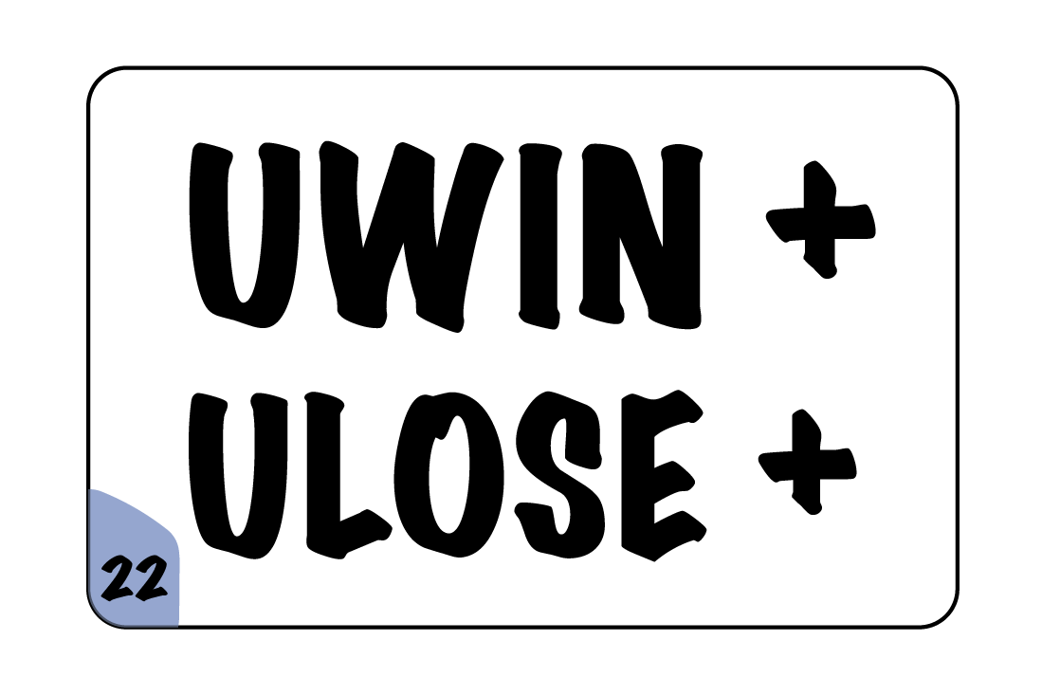
Walk in the park
Neon Lights
Domino
You win some, you lose some
Time after time
Life after death

Slide 14
Touch down
blanket
An after thought
You’re under arrest
Shut up
Day in day out

Slide 15
Read between the lines
Tip of the iceberg
One if by land, two if by sea
West Indies
Make Up
Short walk in the park

Slide 16

Singing in the rain
Tuesday
Space Invaders
Bad influence
Excuse me
Head over heals in love

Slide 17

H2O
Mind Over Matter
Take a step back
Ambiguous
Repeat after me
Downpour

Slide 18
WORDLE SPEED MATCH
No Way On Earth
Perfect circle
Uninterested
I’m beside myself
Torn apart
Minimum and Maximum
1

Slide 19
WORDLE SPEED MATCH
I’m counting on you
One step forward
Two steps back
Circle of friends
I lied under oath
High five
Working under cover
1

Slide 20
WORDLE SPEED MATCH
Double parking
Three degrees below zero
Third blind mice
Small world after all
I understand
Pun intended
1

Slide 21
WORDLE SPEED MATCH
Walk in the park
Neon Lights
Domino
You win some,
You lose some
Time after time
Life after death
1

Slide 22
WORDLE SPEED MATCH
Touch down
Blanket
An after thought
You’re under arrest
Shut up
Day in day out
1

Slide 23
WORDLE SPEED MATCH
One if by land,
Two if by sea
Read between the lines
Tip of the iceberg
West Indies
Make Up
Short walk in the park
1

Slide 24
WORDLE SPEED MATCH
Singing in the rain
Tuesday
Space Invaders
Bad influence
Excuse me
Head over heals in love
1

Slide 25
WORDLE SPEED MATCH
H2O
Mind over Matter
Take a step back
Ambiguous
Repeat after me
Downpour
1

Slide 26
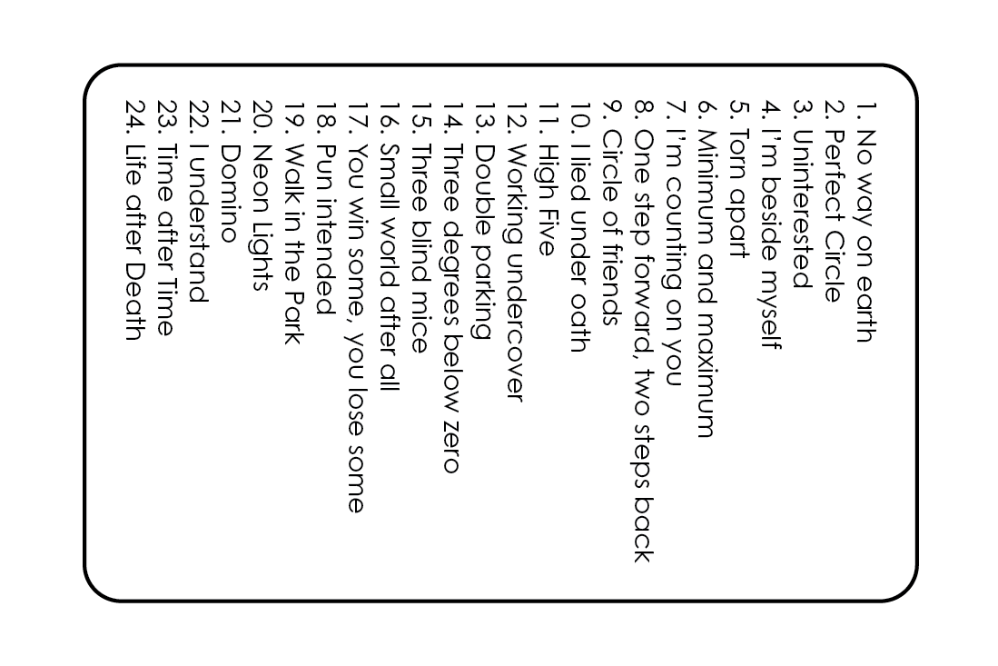
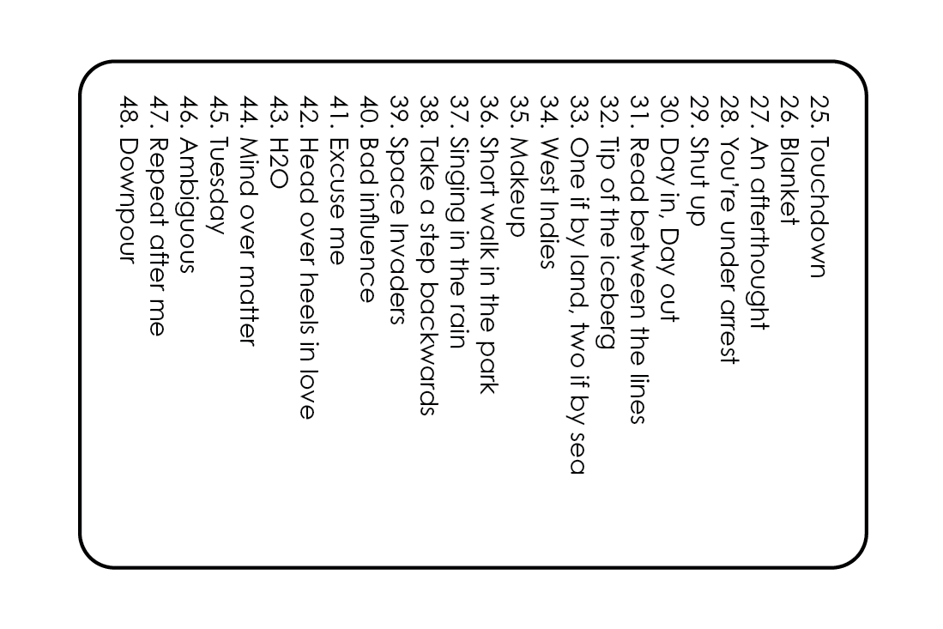
RACING REBUS

